Slide 1

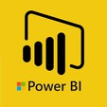
Hii,
Iam Siddhika
Welcome to Power BI Series
Part -75

Slide 2



I’m very excited to dive into this with you all!
Are you ready to enhance your data visualization skills?
We focus only on the most used and important Visuals
Today Content
VISUALIZING DATA
EDIT REPORT INTERACTIONS
SETTING UP INTERACTIONS:

Slide 3

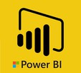
EDIT REPORT INTERACTIONS
check next slide ..
Edit Report Interactions allows you to control how visuals on a report page interact with each other. This feature lets you specify whether a visual should filter, highlight, or ignore selections made in other visuals on the same page.
When to Use Edit Report Interactions
Customizing User Experience: Tailor the report to specific analysis needs by controlling how visuals respond to selections. Preventing Unnecessary Filtering: Avoid irrelevant filtering of visuals, ensuring that only meaningful interactions occur.
Enhancing Clarity: Highlight specific data points without affecting the context of other visuals.

Slide 4

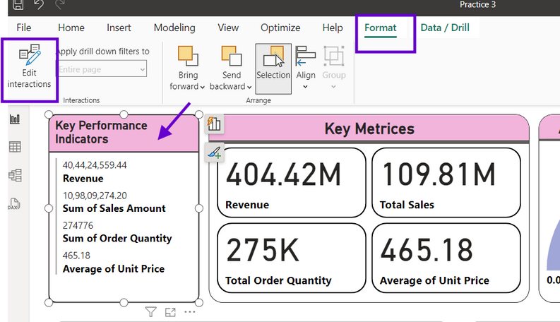
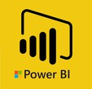
SETTING UP INTERACTIONS:
1. Activate Edit Interactions Mode:
Select a visual on your report page (e.g., the bar chart etc).
In the Power BI ribbon, go to the "Format" tab and select "Edit interactions."
check next..

Slide 5
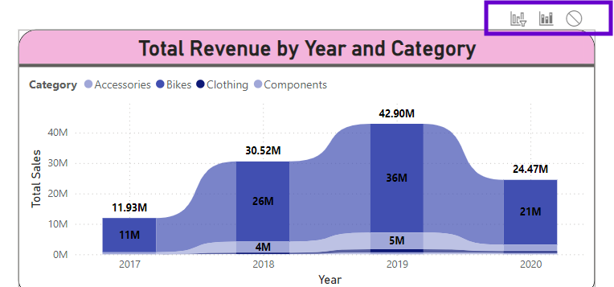
2.Set Interactions:
With "Edit interactions" active, click on each visual to define how it should respond to selections made in the active visual.
we will check each icons in next slide
For each visual, you'll see three icons: Filter, Highlight, and None.

Slide 6

Interaction Types
Filter - This option filters the data in the visual based on the selected data points in another visual.
Highlight - This option highlights the relevant data points in the visual based on the selected data points in another visual.
None - This option ignores the selection and does not change the data displayed in the visual.
Try it out..

Slide 7


Thank you for joining me today to learn about Part -75 of Power BI!
Remember, Effective data visualization is crucial for turning data into meaningful insights and compelling narratives with Power BI.
Stay tuned for more insights and tips on Power BI in our next Series.
Follow
Siddhika Shah

